Slide 1
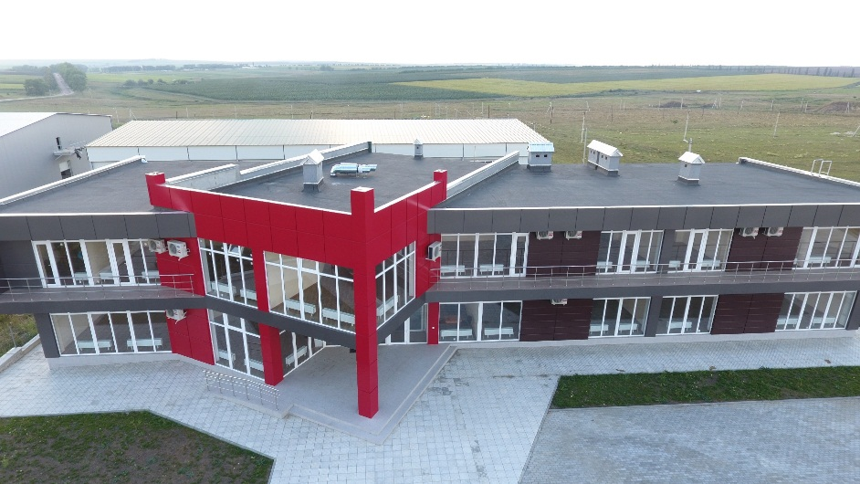
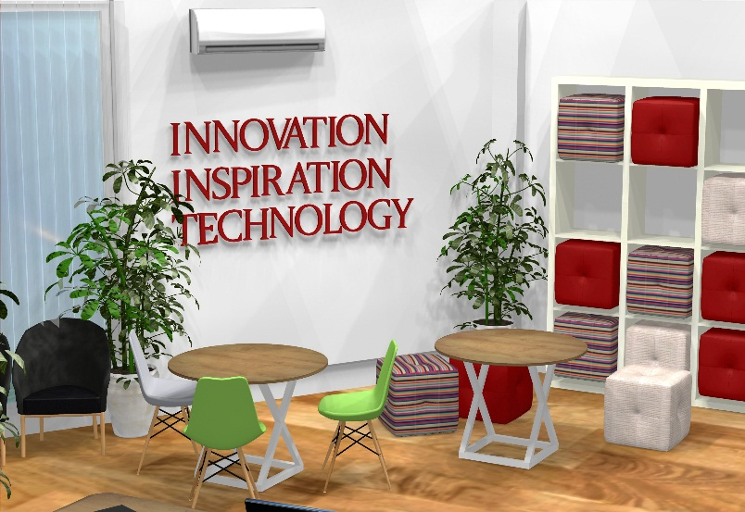
"Industrial Park and Business Incubator - one platform for business promotion in Edinet municipality"
Author: Angela Cascaval
Expert, NGO Community Integrated Development Centre

Slide 2
Edinet municipality- Economic Growth Pole in North Region of Moldova
Edinet profile
Population: 20 200
No of enterprises: 2100
Country: Republic of Moldova, Edinet District
Total Area: 2.2 sq mi (5.7 km²)
Most of businesses are active in the area of trade, hotels and restaurants (26%), but the highest turnover is in the industry (25%).
Economic profile of Edinet municipality
Industry
2% of enterprises operate in industry and construction sector
Agriculture
Peasant Farms (2017): 700 units. 23% of enterprises operate in agriculture sector (mostly animal breeding, cereals and vegetables).
Animal breeding: Edinet is 3rd rayon out of 12 rayons, in terms of production volume.
Vegetables and fruit (global harvest): Edinet is 5th rayon out of 12.
Service
75% of enterprises are operate in service sector. There are 9 branches of banks, 3 savings and loans associations, over 600 retail units, 4 agri-food markets, 25 public catering establishments, 30 public service units (hairdressers, , etc.), 4 hotels.

Slide 3
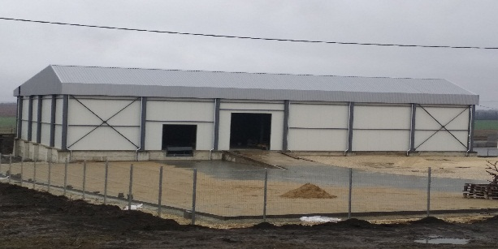
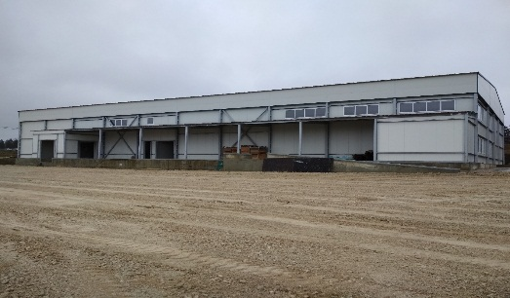
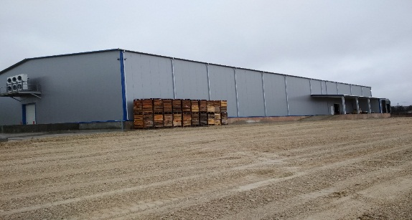
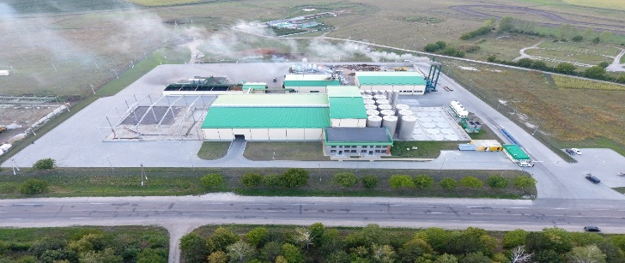
Edinet Industrial Park
Creation: Government Decision no.666 of 02.09.2013 regarding the granting of Industrial Park title
Type: greenfield
Total area: 17,89 ha
Volume of attracted investments: EUR 17 000 000,00
Nr of employees: 120
Nr of residents: 5
Sector of residents' activity: Agro-industrial sector and services.
Infrastructure:
Networks
Water pipe
Natural gas
Road
Telecommunication

Slide 4
Physical infrastructure
Business capacity building
Improving of working conditions
Workforce qualification improving
Networking and cooperation promotion
Integrated approach of business support actions in Edinet municipality

Slide 5
Physical infrastructure
1000 m2 of industrial facility for attracting new investments and creation of new jobs
Business capacity building
Business support services: 3D printing , meetings room and support in solving common problems
Improving of working conditions
providing catering facilities for all employees ( around 120) of the IP and BI residents
one green area for leisure and meetings
Workforce qualification improving
Networking and cooperation promotion
platform and methodology for cooperation with education institutions, labor agency, CCI in order to improve the qualification of the workforce on the local market
established business cooperation with new and micro businesses
Industrial Park

Slide 6
Physical infrastructure
10 equipped offices for newly established businesses
Business capacity building
Trainings and counseling for : business idea generation, providing of core skills in business initiation and development ( 3D design, business computer literacy, internet opportunities for business development, cash flow management, e-marketing, business design thinking and business plan elaboration)
Improving of working conditions
providing catering facilities for all employees of the IP and BI residents
one green area for leisure and meetings
Workforce qualification improving
Networking and cooperation promotion
trainings for the improving business skills and possibility to learn from the experience of advanced businesses through the interaction and communication
established business cooperaation platform with involving of national, regional and local stakeholders
one conference room
one IT training room
one business hub
Hakatons and other business platform meetings for promotion of circular economy, energy efficiency, innovation and other business best practices
business services : accounting , banking , virtual office, business incubation , consulting services.
Business Incubator

